Slide 1
VR Conference
Soft Dev With VR & Gaming
Supervisor – DR Conor Keighrey
By Daniel V

Slide 2
Objective
To Develop an application for businesses / education
Multiple users at a time using photon
Can draw / write on the whiteboard with different marker styles
Presentee & Presenter can move around the scene
Hand tracking

Slide 3
Why this idea?
Education POV
Pandemic highlighted the need for good online learning
Less interaction and easily distracted
VR is closest to real life
Could lower loneliness, stress in hard times
Allows students abroad to attend lectures, increasing student enrolment
Cheaper

Slide 4
Why this idea?
Business POV
Business trip costs reduced
Can have a world wide staff interconnected
More availability when organising conferences

Slide 5
Research angle
Will create list of questions
Different age group testing to determine difficulty of application
Questionnaire Focus
what would they use it for
See if students would benefit from this during covid
Ask for more features that could be added
Test to see heart rate while using application, seated to non seated - Stress

Slide 6
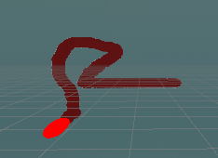
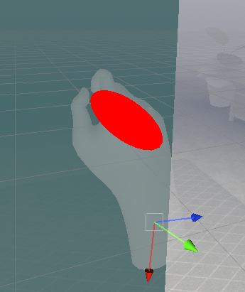
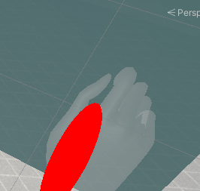
Work so far
Repository created & cloned
Project set up – Oculus XR plugin, Oculus Integration
Marker
Sphere object with rigid body, collider and scripts to allow grab with the pinch technique
Issues
The sphere object makes hand placement awkward
Must set placement ahead of marker to be central in real time
Keeping colour
Changed the cameras background type from skybox to uninitialized
Set the culling mask to the marker layer – only reads marker

Slide 7
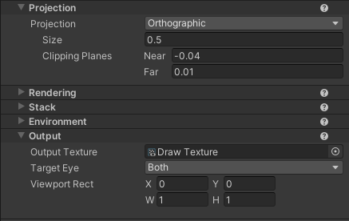
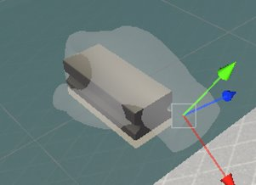
Work so far
Whiteboard
Plane with camera child
New render texture set as output texture on camera
Everything touching plane will be seen by the camera now
Duster
3D asset from google
Bottom layer set transparency to 0

Slide 8

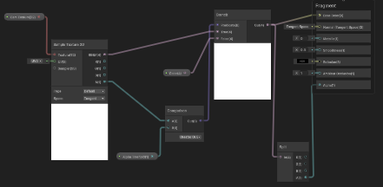
Work so far
Shader
Allows plane to change colour and transparency
3 param
Colour for background colour change
Float for transparency change
Texture2D what camera will see when draw
Node – Texture2D; check for terrain
Node – Comparison; checks for drawing
Node – Branch; Compares if paint there by looking at the alpha value, if it is greater than a certain threshold then uses my sample texture
Node – Split; Use of alpha value of the colour and the cam texture
Surface to transparent in the graph inspector
Set plane to this shader with threshold 0.1

Slide 9
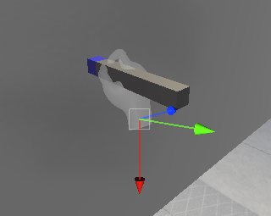
Old design
Whiteboard
Plane
Had script to set texture resolution
Marker
3D Cube object
Had script to calculate the position and the rotation of the marker
How often a 5x5 square pixel would be drawn on the whiteboard
Issues
FPS drop when the marker would calculate each pixel when drawing on whiteboard

Slide 10
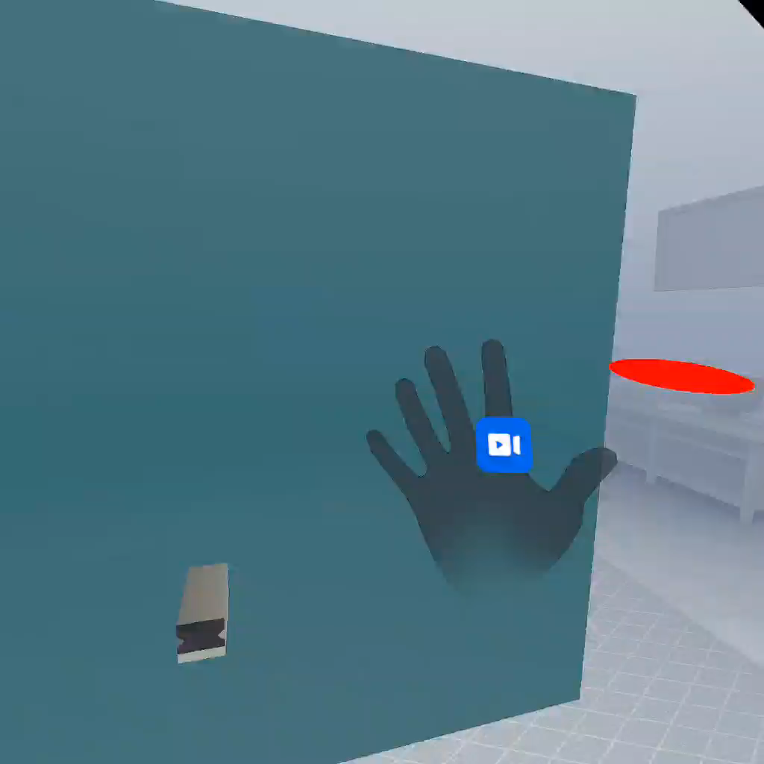
Future
Risks
Demo
Not enough room – Clear area
Update – Might cause issues
Allowing casting of screen
Allow multiple users to participate
Allow movement around scene
Physics
Scene creation

